Slide 1
Composable AI : Robotics Augmented by Artificial Intelligence — Vishal Chahal Chief Architect – Cognitive Solutions IBM GSI Labs

Slide 2
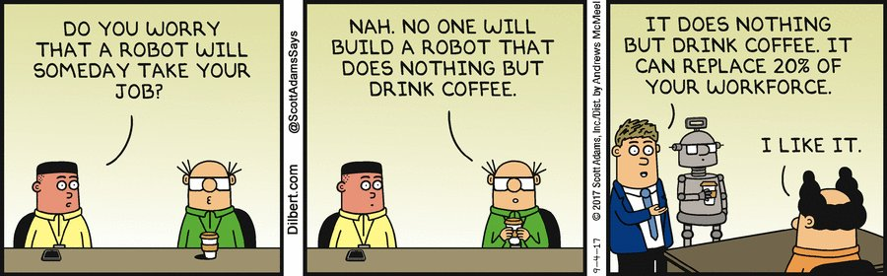
“People worry that computers will get too smart and take over the world, but the real problem is that they're too stupid and they've already taken over the world. “
Pedro Domingos, professor at University of Washington and researcher in machine learning

Slide 3
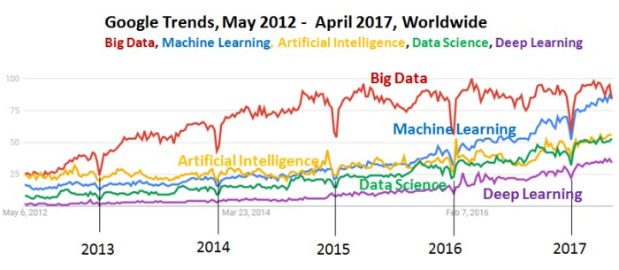
Just buzzwords?
Notes:
http://www.kdnuggets.com/images/google-trends-big-data-machine-learning-ai-ds-dl-april-2017.jpg

Slide 4
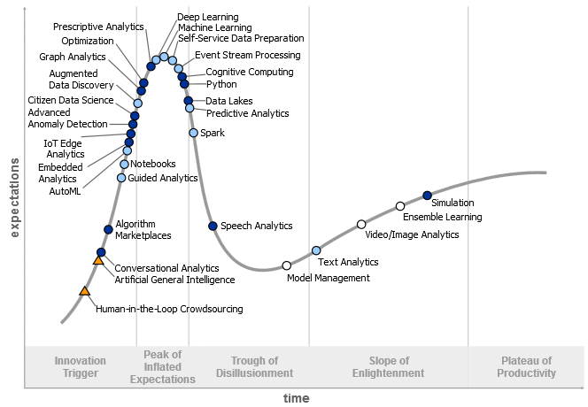

Hype Cycle for Data Science
Source: Gartner (2017)

Slide 5
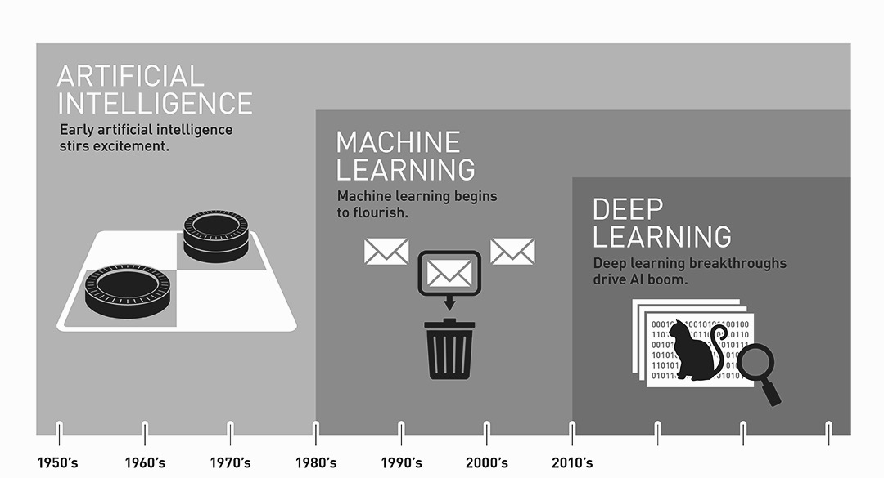
Era of AI
Traditional AI
Feature engineering
Human-annotated data types
Sequential computation
Modern AI
Hierarchical model with layers of abstraction
Unlabeled data types
Multiple decisions simultaneously

Slide 6
What is Artificial Intelligence ?
THOUGHT
Systems that think like humans
Systems that think rationally
Inferential Statistics
Systems that act like humans
Systems that act rationally
BEHAVIOUR
HUMAN
RATIONAL

Slide 7
Areas of AI and Some Dependencies
Inferential Reasoning
Knowledge Representation
Search
Logic
Machine Learning
Planning
Expert Systems
NLP
Vision
Robotics

Slide 8
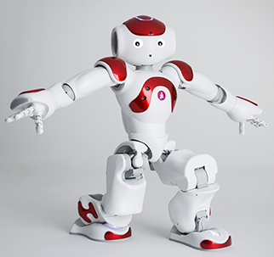
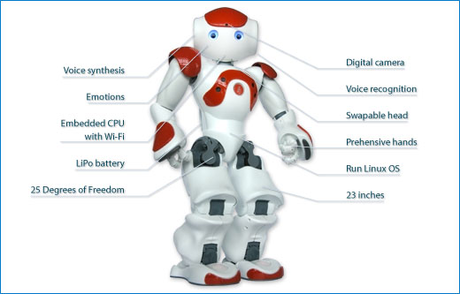
Nao is a humanoid robot Developed by SoftBank Robotics Originated at Aldebaran in France Nao’s can play the roles of An ‘Hospitality’ Robot A Companion Robot
NaoQi operating system, Linux-based OS
SSH/FTP/… available to administer the robot
Distributed objects system (NaoQi), extensible

Slide 9
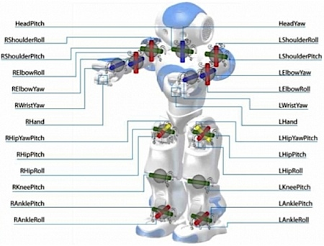
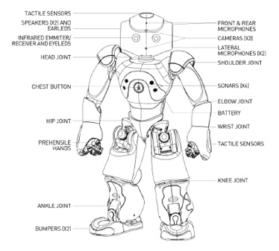
Quad core CPU, 4GB RAM, 8GB SRAM, 16GB SSD, many peripheral controllers to drive robotics 14 motors, 30 sensors, Large Battery, 12-18h autonomy, Connectivity: Wifi 802.11 a/b/g/n, wired Ethernet (head)

Slide 10
Software and Programming: Choregraphe, “wiring composable boxes”, code written in Python, Virtual Robot Emulation, Robot animation Automation, NO MAGIC, Native C++, Distributed Objects platform

Slide 11
Challenges of AI for Enterprise: Reasoning
Challenges of AI in Robotics: Reasoning
Humanoid Robots are driven by autonomous functions – Behaviors
Behaviors can be augmented by AI, but current techniques are more aligned towards discreet instantiation of AI
Using current methods Robots can’t make sense of the world without help from large amounts of carefully labeled data driven DL models; they aren’t suited to everything
Notes:
It is not sufficient to tell me “What it is” – we need to know “Why” within the enterprise
We are justified in holding algorithms to even higher standards of explainability than people, because the algorithms could be buggy or outdated.

Slide 12
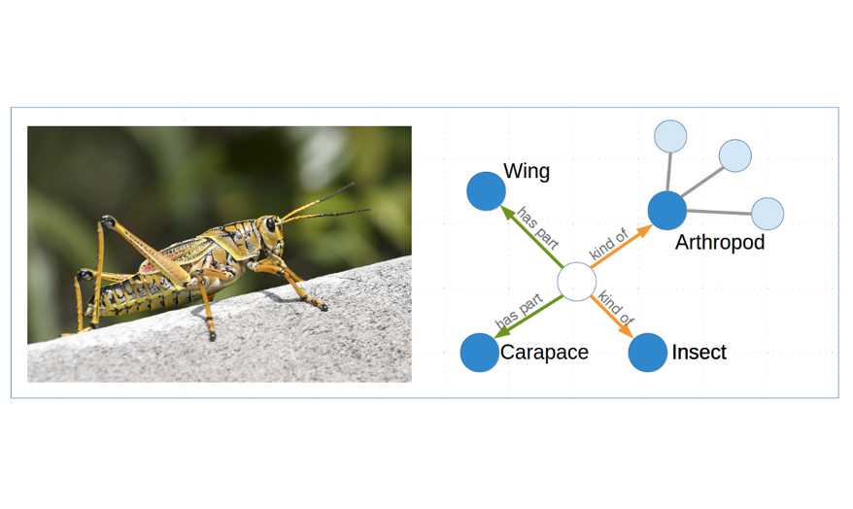
Composable AI : Evidence and knowledge graphs based reasoning

Slide 13




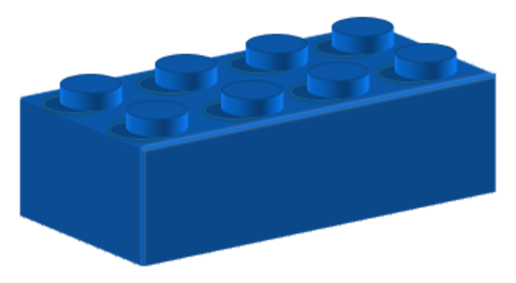

Composable AI
Generic
Behaviors
Generic
Features
DL model
Sensor
Patterns

Slide 14
Thank you.
Vishal Chahal
Chief Architect – Cognitive Solutions
IBM GSI Labs
—
vchahal@in.ibm.com
+91-9886681946
ibm.com

